Slide 1
Contract-First API Design
Ishan Malik

Slide 2
Business use cases and Consumer journeys
A business use case describes an action a user or system wants to complete to solve a real business need.
A business use case explains why an API is needed and what business problem it solves.
A consumer journey explains how a user moves from one API call to another to complete one task.
A consumer journey shows the complete step-by-step path followed by the API user.

Slide 3
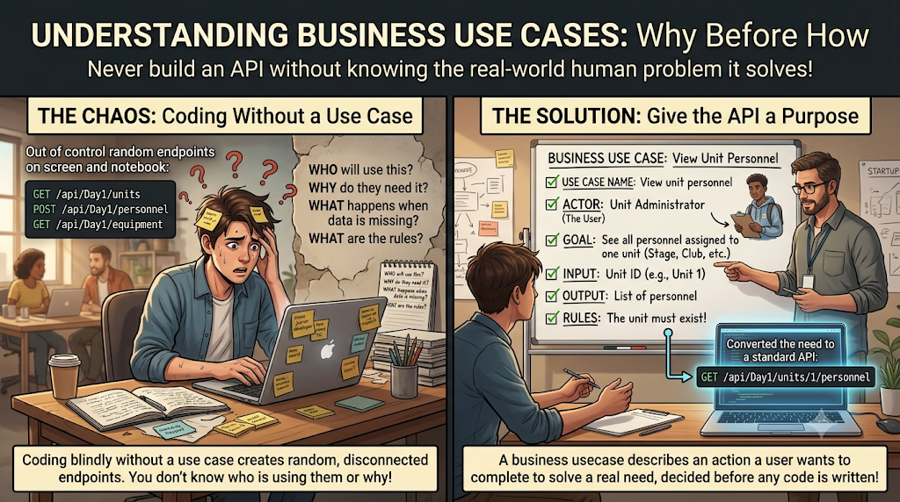

Slide 4
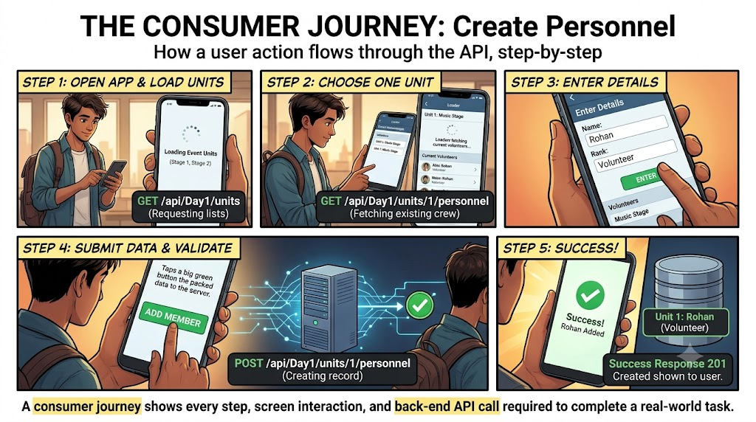

Slide 5
Business Use Case vs Consumer Journey
Topic | Business Use Case | Consumer Journey
Main question | What business problem are we solving? | How does user/system complete the task?
Focus | Business goal | API call sequence
Example | Add personnel to a unit | Get units → select unit → POST personnel
Written for | Business user, developer, tester | API consumer, frontend developer, tester

Slide 6
Functional and non-functional requirements
Functional requirements are the tasks the system must perform.
A functional requirement says what the API must do.
A non-functional requirement, often called NFR, says how well the API should work.

Slide 7
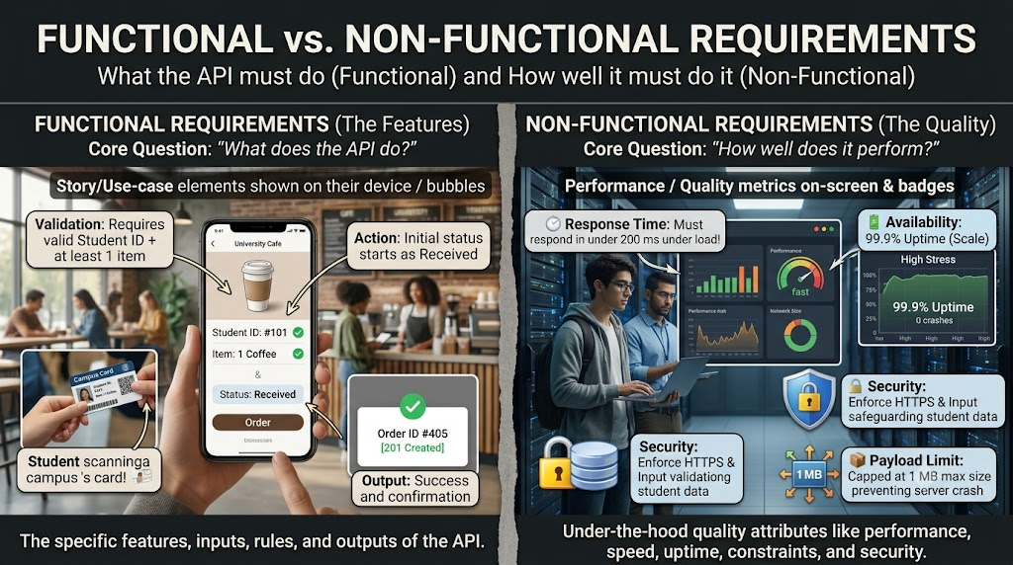

Slide 8
Open API
An OpenAPI Specification (OAS) is a standard, language-neutral format used to describe, document, and design REST APIs using JSON or YAML.
It is a structured blueprint that describes the endpoints, request payloads, response schemas, and authentication methods of a RESTful API.
Think of an OpenAPI file as an instruction manual or floor plan for a restaurant kitchen:
  Instead of tasting the food to find out how it is made, you read the menu blueprint first.
  It tells customers (developers) what dishes exist (endpoints), how to order them (HTTP methods like GET or POST), what data to send (parameters), and what dish comes back (response).

